Slide 1
Arrays Functions and Operators

Slide 2
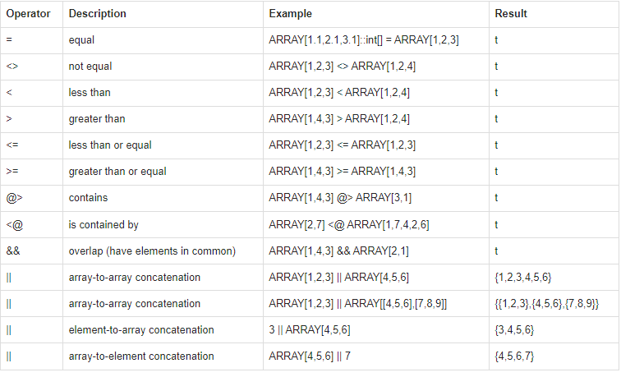
Array Operators

Slide 3
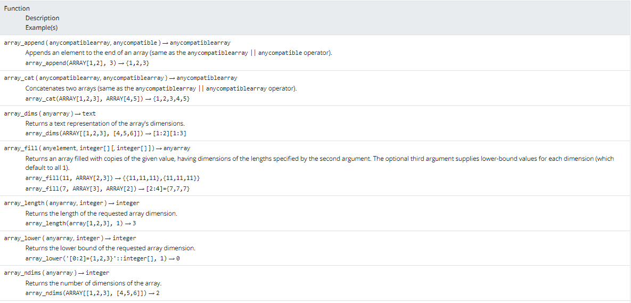
Array Functions

Slide 4
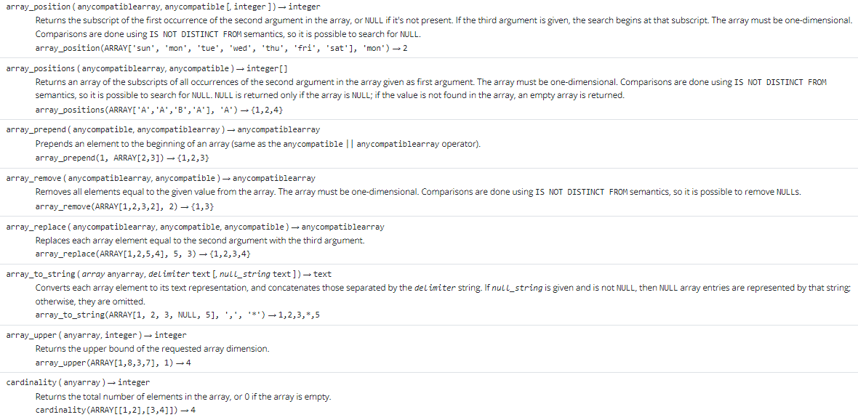
Array Functions

Slide 5
